Slide 1
Optimal Control of Household Temperatures During Daytime Hours
Thomas Richardson

Slide 2
Idea and Objectives
Houses are typically left unoccupied while people are at work, but ideal comfort temperatures are maintained
Can energy costs, and therefore monetary costs, be reduced by modifying how temperature control is handled during these hours?
How can we go about controlling these “away time” temperatures?
Notes:
Main question behind this: can we save energy and money by not keeping our homes at the ideal temperature while away for long periods of time during the day (order of 10 hours or so)
Daily activity, so potential for significant impact on electric bills, energy usage
Technology at this point in time is clearly at a level that something like this could be implemented fairly cheaply

Slide 3
Ideal Control System
Control system can predict how temperature is going to change throughout the day given some starting conditions
Control system can predict the actual effect of these environmental factors on the temperature of rooms in the house
Control system can predict how the state of the internal system will evolve in response to controls it enacts given the properties of the house system
Notes:
If we could have some near-perfect control system, what kind of capabilities would it have and what information would it have?
From here, we can decide on which factors are most important in conducting simulations
Needs: weather prediction, not just temperature, but also things like humidity, wind, solar intensity
How the system changes with time based on these on controllable factors, and control elements

Slide 4
What We’re Working With
Have temperature data for “away time” hours
Assume we have an estimate of how these temperatures affect the internal state of the house (note: only temperatures considered in this case)
Assume we have some estimate of how the state of the house evolves due to various factors
In some cases, assume we have some idea of what an optimal control looks like
Working with quite a few assumptions
Notes:
parameter assumptions (control needs to be powerful enough to outheat thermal losses / outcool thermal gains

Slide 5
Structure of Simulation
Outer optimizer
“Actual” state evolution fed into outer optimizer
Inner optimizer
Control state simulation fed into inner optimizer
IOpt
“Global” Control Opt
State
COpt

Slide 6
Typical Iteration
Start outer optimizer with given set of parameters (number of sections to divide control into, various thresholds for updating, error tolerance)
Simulate some selection of days for given parameter set
For each day:
set some initial control
while simulating state, check for deviation in control predicted system state and the actual system state
if conditions are met, use optimizer to find new control (restrict info)
repeat as necessary
Repeat
Repeat
Notes:
note that inner optimizer only looks at cost to go from current time → causes distance from final desired state to become more important as time progresses
error checking at every step of the state ode solver for violations
needed to force ode solver to take certain steps (25 min intervals, at least)

Slide 7
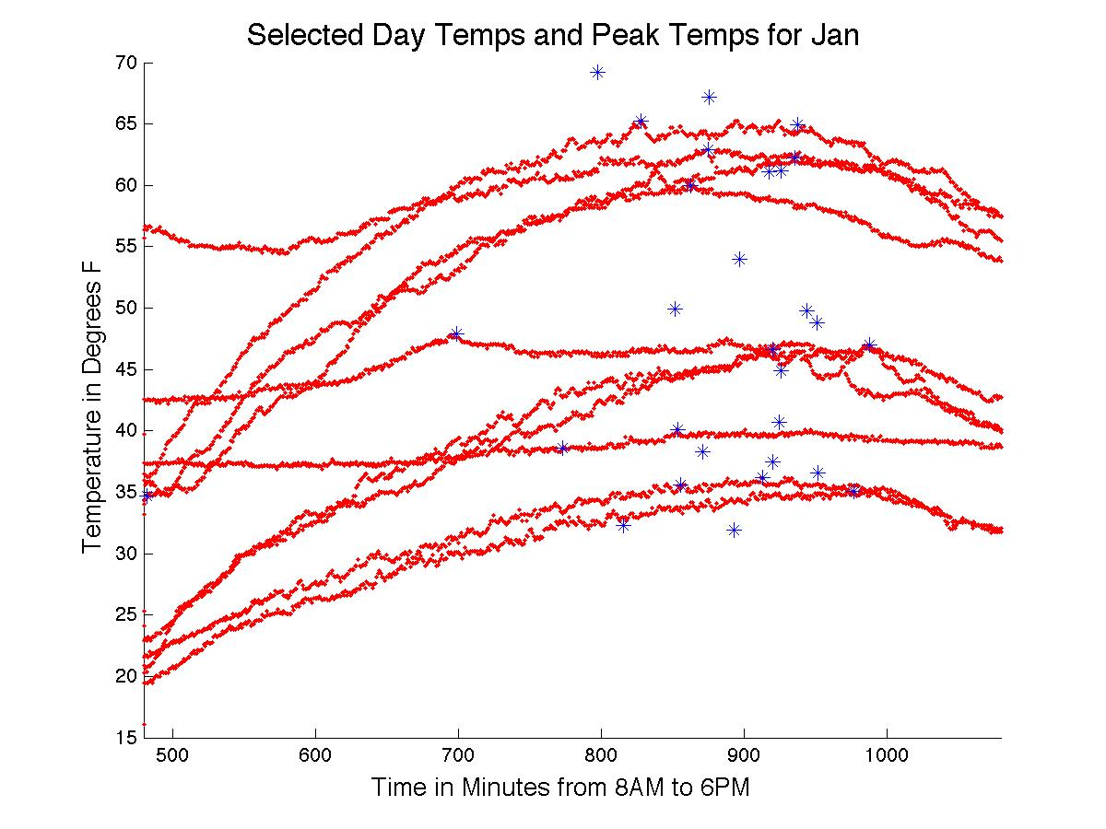
Temperature Estimation
Some sort of learning algorithm (ANNs, GAs) would be ideal with historical data, current weather forcasts
Quick and dirty / simple linear approximation based on expected peak temperature time was used instead
Notes:
Because of model chosen, had some problems with temperature patterns that significantly strayed from the triangle function, such as early peaking and plateau-ing
Current model tends to overestimate peak temperature early on. Note this doesn’t really affect the control policy all that much, since, as we’ll see, it’s back-loaded anyway
Also, since the system provided to the control was not very different from the one for the actual simulated system, a rougher temperature estimation provided for more fun
Pretty good local predictor, which cased problems with the ode solver, as it decided to hop along and grossly skipped over threshold error level

Slide 8
What does the Control look like?
Temperature setting
Output Level setting
Fraction of total flow distributed to each room
Resulting temperature change due to control is a function of the product of these elements, so we cannot utilize much of the optimal control theory
Cannot just use resulting product as control, as the various factors would be needed to determine the state changes
f(u,T) = k*(TempCont-TempRoom)*(Level)*(Fraction)
u is the Control and T is the current room temps.
Continuous spline or piecewise constant

Slide 9
System Dynamics
Can write system as: dx = Ax + f(u,T) + g(w,T)
The diagonal elements of A relate thermal losses from a particular room to other rooms and the external environment, while off diagonal elements of A are the coefficients associated with thermal gains from other rooms.
In this case, g(w,T) is simply D*w, where D is a vector of coefficients meant to describe thermal exchange between the external environment and individual rooms, and w is the external temperature.

Slide 10
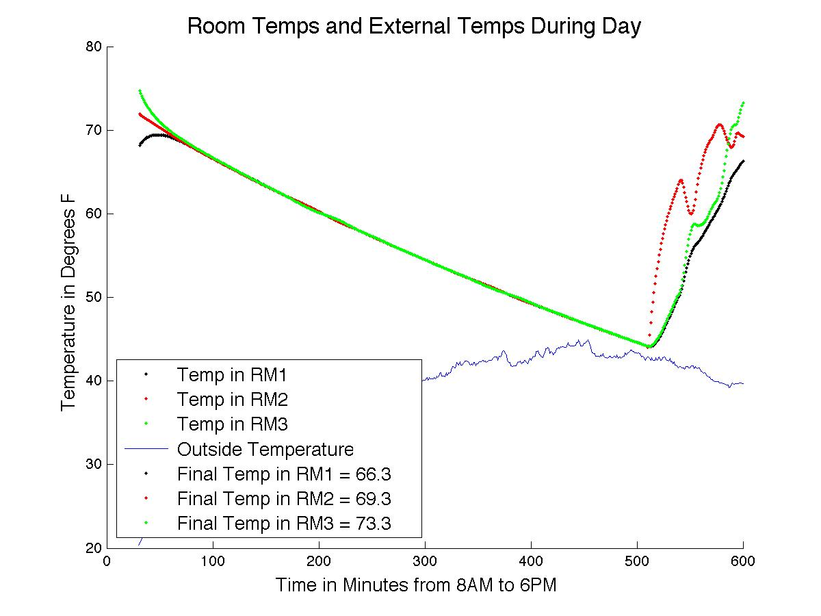
Notes:
drastic temperature changes than what could prob be expected to realistically occur
Show other images as well
note “strange” behavior
talk about how final distance from specified conditions becomes more important in cost as

Slide 11
General Observations and Follow-up
The optimizer is not very good at getting to actual desired parameters given the particular settings, but does a nice job of getting in the close vicinity. Consider hybrid control system.
fmincon works well for general problems; a more specific optimizer may be constructed for this specific problem.
Current system limited in scope. Would like to expand to other factors (humidity, sunlight, wind, electricity pricing), better information (weather forecasting, more comprehensive data analysis)

